Slide 1
Cyber-Consciousness
Dr Steve Battle
Cybernetics Society, and University of the West of England

Slide 2
“As the beating slowly normalized he'd think of how his heart, unlike him, was safely contained, away from the world, behind bone and inside skin, held by muscles and arteries in its place, carefully off-center, as if to artfully assert itself as source and creator, having grown the chest to hide in and to muffle and absorb—and, later, after innovating the brain and face and limbs, to convert into productive behavior—its uncontrollable, indefensible, unexplainable, embarrassing squeezing of itself.”
‘Cyber-consciousness’ from Tao Lin’s novel, ‘Taipei’ (2013)
Notes:
https://www.vonglasersfeld.com/125.2

Slide 3
Overview
This talk is about:
An Introduction to Cybernetics
Cyber-Consciousness – A cybernetic approach to consciousness
Fun experiments with robots in a simulated world.
Future directions.

Slide 4
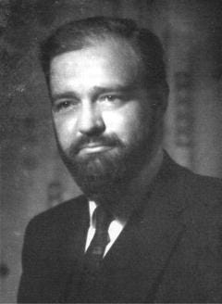
Cybernetics
Norbert Wiener defines cybernetics as “control and communication in the animal and the machine.” (1948)
“the most advanced type of control machinery we know about is surely found in the central nervous system of the human body” Stafford Beer.
Stafford Beer
Notes:
Beer S. (2002) “Kybernetes: What is Cybernetics?” https://www.emeraldinsight.com/doi/full/10.1108/03684920210417283.

Slide 5
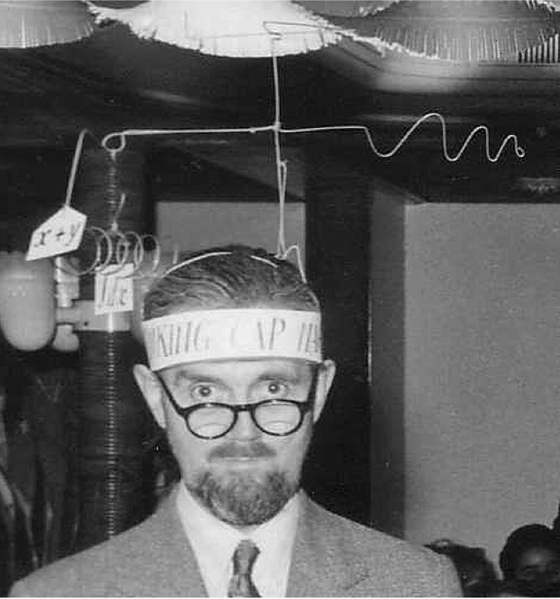
Information Closure
In An Introduction to Cybernetics (1956), Ross Ashby states:
It does not ask “what is this thing?” but “what does it do?”
“Cybernetics might, in fact, be defined as the study of systems that are open to energy but closed to information and control – systems that are "information-tight."
Ross Ashby and his "Thinking Cap"
Notes:
https://harishsnotebook.wordpress.com/2023/02/05/informational-closure-in-the-human-and-the-machine/#:~:text=This%20idea%20was%20introduced%20by,are%20“information%2Dtight”.
W. Ross Ashby, An Introduction to Cyberneticxs, Chapman & Hall, 1956.

Slide 6
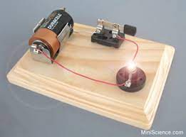
Information closure
When we flick a light switch on and off, we don’t provide information to the electric circuit.
We simply perturb the circuit which responds according to its internal structure – a light bulb turns on & off.
Any information is in the eyes of the observer.
The circuit itself is closed to information.

Slide 7
If there is no other, there will be no I. If there is no I, there will be none to make distinctions.
Chuang-tsu, 4th Cent., B.C.
Notes:
https://www.vonglasersfeld.com/125.2

Slide 8
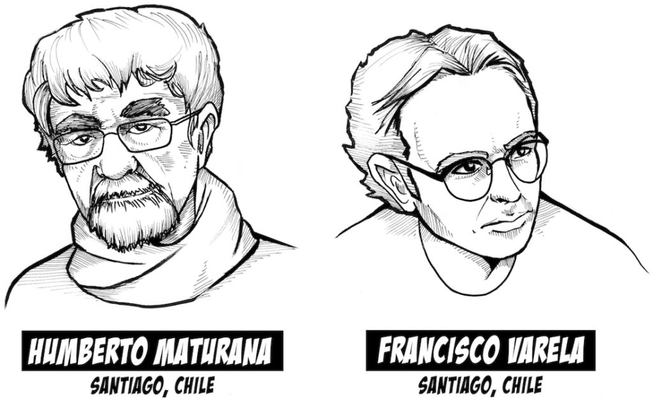
Living Machines
Inspired by Ashby, Chilean cyberneticians took the idea further.
“A universe comes into being when a space is severed into two. A unity is defined.”
Autopoiesis and Cognition: The Realization of the Living (1972)

Slide 9
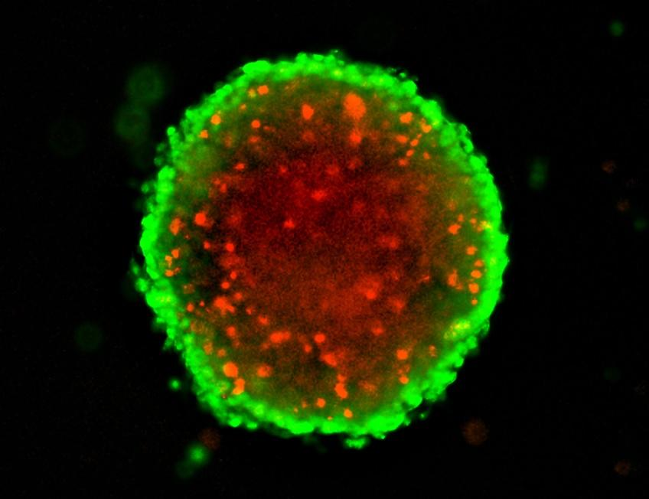
Structural Closure
The emergence of a boundary dividing self from non-self.
cell wall
soap bubble
corral

Slide 10
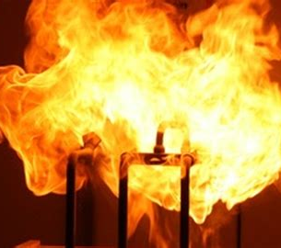
Organisational Closure
A network of processes for self-production of components.
chemical reactions
fire
nuclear bomb
Covid virus
Krebs cycle

Slide 11
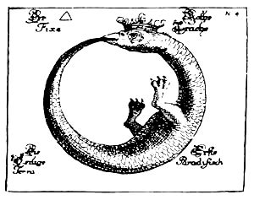
Autopoiesis
From Greek:
“auto” (self)
“poiesis” (creation)
Autopoiesis is synonymous with life.
Life = Organisational Closure
+ Structural closure

Slide 12
Autopoiesis
autopoiesis implies that any changes living systems make are determined by their own organization and structure.
It is not the light shining on a plant that causes it to respond, the light triggers a response based on the plant’s organization and structure.
Notes:
https://onlinelibrary.wiley.com/doi/pdf/10.1046/j..1988.00323.x

Slide 13
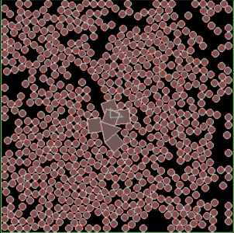
Artificial Autopoiesis
2D Chemical simulation.
Particles react ‘chemically’ when they collide.
Closed boundary forms, like a cell wall, enclosing the (triangular) catalyst.
The system acts to maintain this unity.

Slide 14
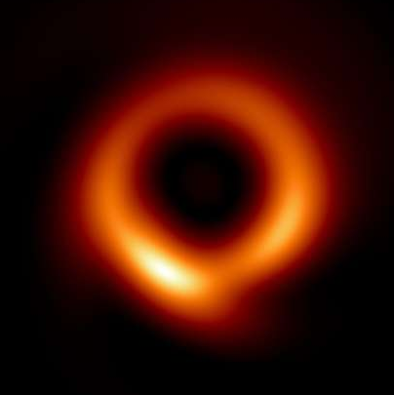
Information / Event Horizon
single cell
Communicative interactions are not informative (but can be causal).
Hence, there can be no internal symbolic representations of the external world in any meaningful sense.
We can, of course, look inside brains (e.g. CT scans). But who is the observer?
black hole in M87

Slide 15
A distinction is drawn by arranging a boundary with separate sides so that a point on one side cannot reach the other side without crossing the boundary.
G. Spencer Brown, Laws of Form (1969)
Notes:
https://www.vonglasersfeld.com/125.2

Slide 16
Crossing the Boundary
Structural coupling is the relationship between an autopoietic system and its environment.
If an organism is able to continue functioning as a living autopoietic unity, it must be coupled to its medium.
structural coupling is the building block of all human and animal interactions.
Notes:
https://onlinelibrary.wiley.com/doi/pdf/10.1046/j..1988.00323.x

Slide 17
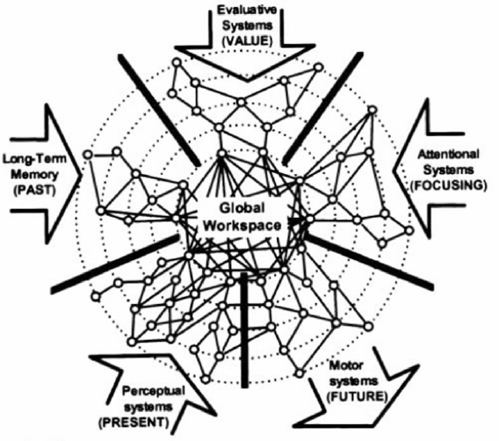
Global Workspace Theory Bernard Baars, 1988
Inspired by early symbolic AI blackboard architectures where the workspace allows programs to exchange information.
Consciousness is a dynamic workspace that enables competition and cooperation.
Matches introspective experience of a ‘theatre of the mind’ and focus of attention.
Approximately – Workspace contents correspond to whatever we are conscious of.
consistent with sequential stream of consciousness
Notes:
https://philpapers.org/rec/BAAACT
Baars, Bernard J. (1988). A Cognitive Theory of Consciousness. Cambridge University Press.

Slide 18
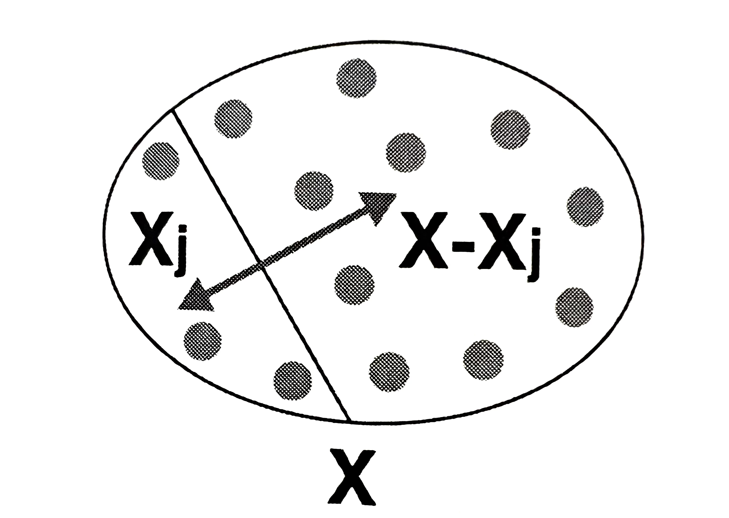
Integrated Information Theory (IIT) Giulio Tononi, 2004
IIT proposes a mathematical model of consciousness.
IIT 2.0 computes mutual information, I, between the system’s past and present states.
IIT 3.0 proposes the Φ (phi) metric to quantify consciousness.
However, calculation of Φ is computationally intractable.
Mutual information across brain states

Slide 19
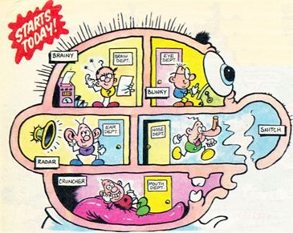
Multiple Drafts Model (Dennet)
There is no ‘Cartesian Theatre’ in the brain.
The work done by the imaginary homunculus in the Cartesian Theatre is broken up and distributed to different agencies in the brain.
consciousness is not what it seems to be – a magic show illuminating an inner stage.
The Numskulls (Beano)

Slide 20
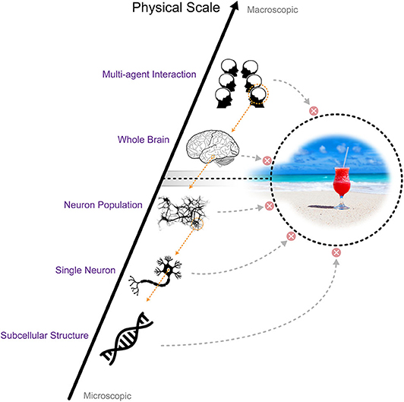
Information Closure Theory Chang et al, 2020
ICT proposes conscious processes occur at a coarse scale. We’re unaware of fine-grained neural events.
ICT attempts to formalize and quantify information closure.
Bertschinger (2006) defines a system as informationally closed when information flow from the environment to the system is zero.
Information closure is trivial if the environment and the system are independent of each other.
But, in the non-trivial case the system must accurately model the environment.
Notes:
https://books.google.co.uk/books?hl=en&lr=&id=3kuT8-FpBCQC&oi=fnd&pg=PA9&ots=zFMgHG4nij&sig=zUGNsMOHiPKo4mU1mwErEwCXmyE&redir_esc=y#v=onepage&q&f=false
https://www.frontiersin.org/articles/10.3389/fpsyg.2020.01504/full

Slide 21
Perceptual Control Theory (PCT) and Consciousness Warren Mansell, 2021
Behaviour is the control of perception (Bill Powers, 1973)
Powers described consciousness within a living control system as a way to resolve conflicts – the reorganization of the system.
Yet consciousness thrives, even when essential/intrinsic variables are satisfied.
Proposes that an additional system must allow curiosity-driven ‘creative’ error to occur and produce reorganization.
Is reorganization or learning necessary for consciousness? Or can one simply be mindful of an activity?
Notes:
https://www.researchgate.net/publication/356391606_An_Integrative_Control_Theory_Perspective_on_Consciousness

Slide 22
Cyber-Consciousness
Information closure is quite a constraint if we take it seriously.
Qualitative approach to information closure (unlike ICT).
Quantify information integration (like IIT 2.0) at the boundary (unlike IIT).
No computational / representational ‘mental theatre’ (unlike GWT)
Embodiment: consciousness is the interaction between a system and its environment. Not computational but enactive.
Evaluate the control of perception (like PCT) but not re-organisation.
Consciousness equates to integrated activity at the control surface.

Slide 23
The Control Surface
The boundary enables observation – boundary crossing
The boundary enables two-way interaction – structural coupling
The boundary intersects feedback control loops – the control surface
Information acquires meaning when linked to purpose.
Hypothesis:
We can measure Information integration at the control surface.
control surface
feedback loop

Slide 24
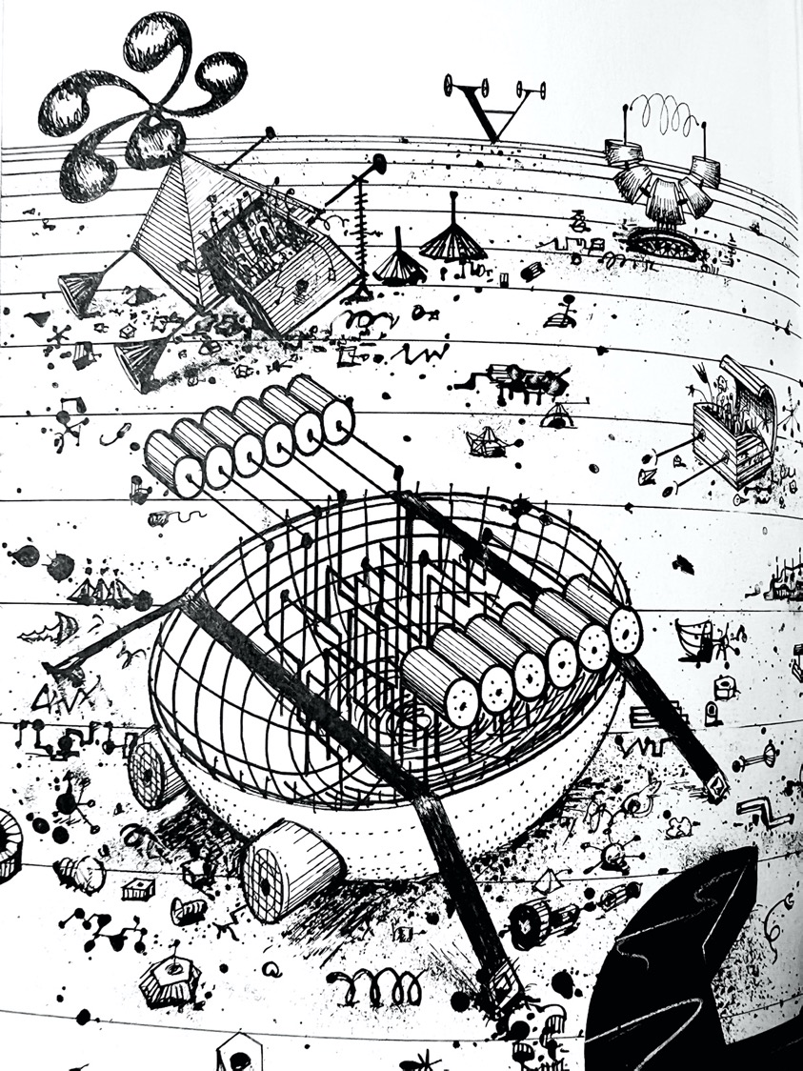
Vehicles of Thought
Use simple robotic vehicles as a thought experiment and in simulation to try out these ideas.
Vehicles are not autopoietic.
They are autonomous (organizational closure alone)

Slide 25

Vehicles Experiments in Synthetic Psychology Valentino Braitenberg, 1984
“This is an exercise in fictional science, or science fiction, if you like that better. Not for amusement: science fiction in the service of science.” – Braitenberg
Notes:
See also Marken & Powers “Random-walk chemotaxis” of E. Coli in ‘Mind Readings’.

Slide 26
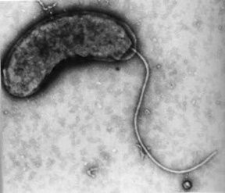
Nature’s Vehicles: E Coli
The flagellum is a long hollow filament
At the base, a flagellar motor rotates around 100 revolutions per second.
The direction of rotation determines the kind of movement.

Slide 27
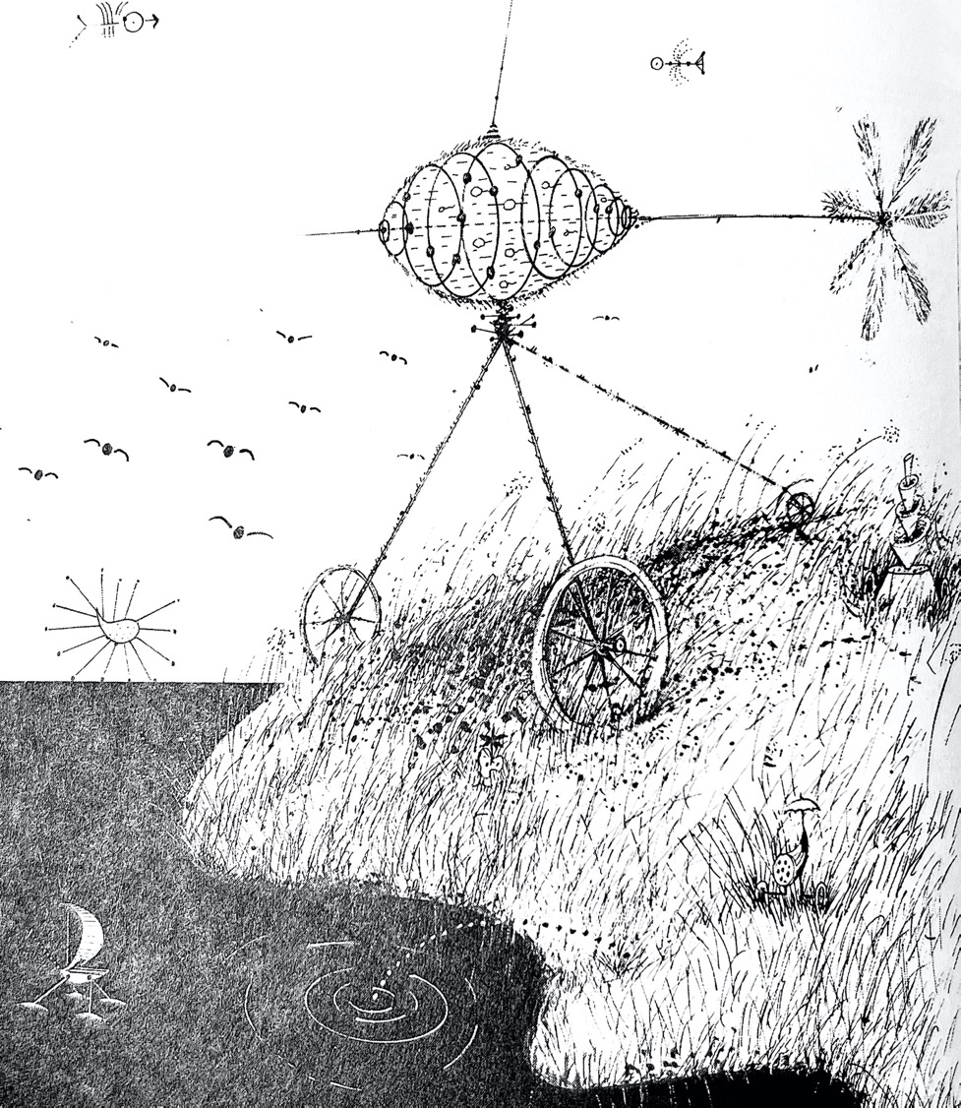
Getting Around
Vehicle 1 has one sensor and one motor.
The motor is anything that can provide a propulsive force, not just electric motors.
The sensor can be of any kind of analogue detector.
This is the control surface

Slide 28
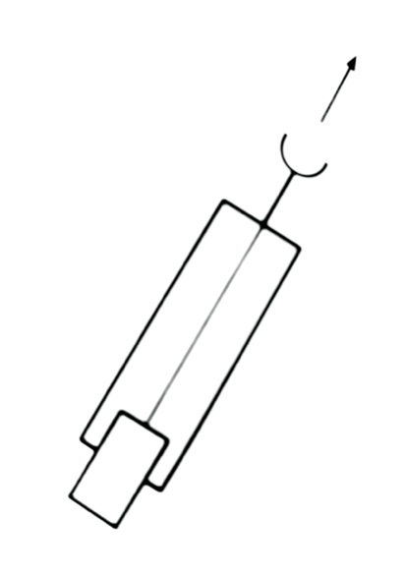
Vehicle 1
The signal is conveyed from the sensor to the motor by a nerve fibre, causing the motor to vary continuously in its output.
“The more there is of the quality to which the sensor is tuned, the faster the motor goes” - Braitenberg.

Slide 29
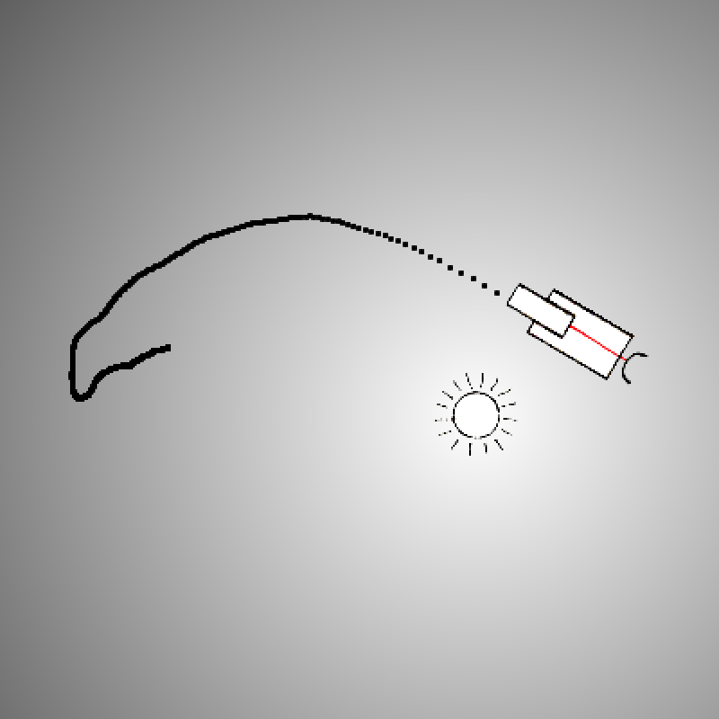
Braitenberg Vehicle 1: Getting Around
“Once you let friction come into the picture, other amazing things might happen. As the vehicle pushes forward against frictional forces, it will deviate from its course.” Valentino Braitenberg
https://go.uwe.ac.uk/v1
Notes:
S-R tells the story from input to output - the computational story. HALF the story.
one sensor and one motor. Light acts as direct stimulus for the motor.
No steering control.
Braitenberg also teases us with a poetic purposeful description.

Slide 30
Simple eye
The brighter the light, the faster it drives the motor.
Apparent brightness varies with angle to light source.
The eye is an idealised photocell following Lambert’s cosine law.
No signal from a light source behind the vehicle.
This half-rectification brings V1 to a halt just beyond the light.
- $\frac{\text{π}}{2}$
$$\frac{\text{π}}{2}$$
0
𝜋
dead ahead
The eye of V1 produces a signal that varies with the half-rectified cosine of the angle to the light source.

Slide 31
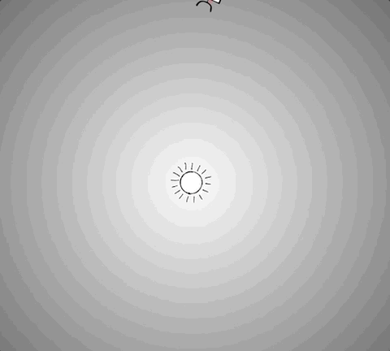
The Controlled Variable
A controlled variable is some aspect of the perceived environment that the vehicle effects to achieve its goal.
What is the Vehicle trying to control - what is its purpose?
The controlled variable is on the control surface

Slide 32

Experiment 1
Vehicle 1 moves towards the light.
Hypothesis: The controlled variable is the distance from the light source.
Hypothesis: There is significant mutual information between the eye and distance.
https://bit.ly/3v8wu3r

Slide 33
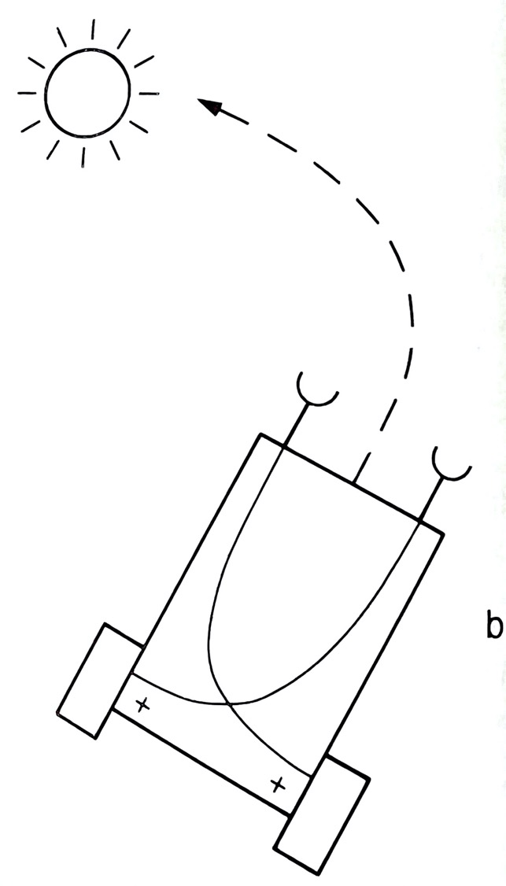
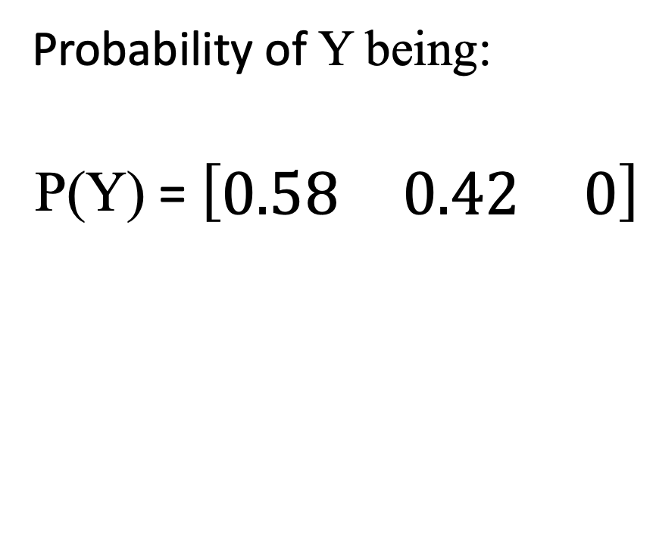
Test for the Controlled Variable
Y is the distance from the light.
Intermittently disturb the vehicle to see which states it settles back into.
Coarse distinction of 3 bins
Count & normalise occurrences.
Probability of Y being:
P(Y) = $\left[\begin{matrix}0.58 & 0.42 & 0\end{matrix}\right]$
near far

Slide 34
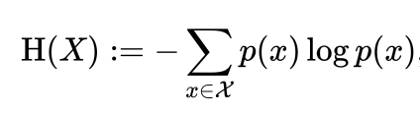
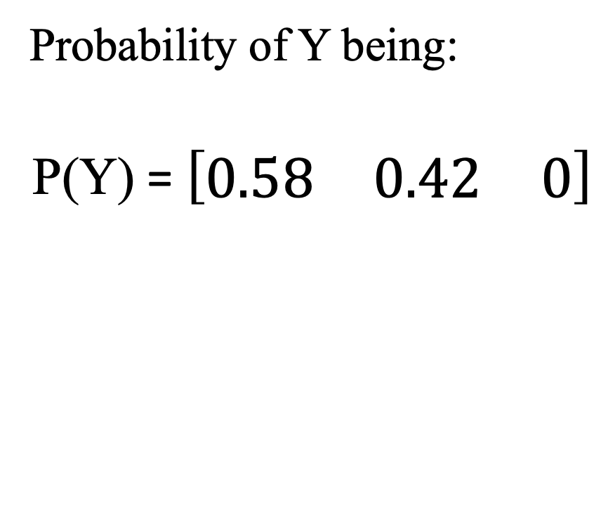
Entropy
The entropy of the distance, Y, H(Y) = 0.98 bit
H(Y) increases with uncertainty.
It’s highly likely to be found in the proximity of the light source.
This is evidence of control.
Probability of Y being:
P(Y) = $\left[\begin{matrix}0.58 & 0.42 & 0\end{matrix}\right]$
near far
H(Y) = 0.98 bit

Slide 35
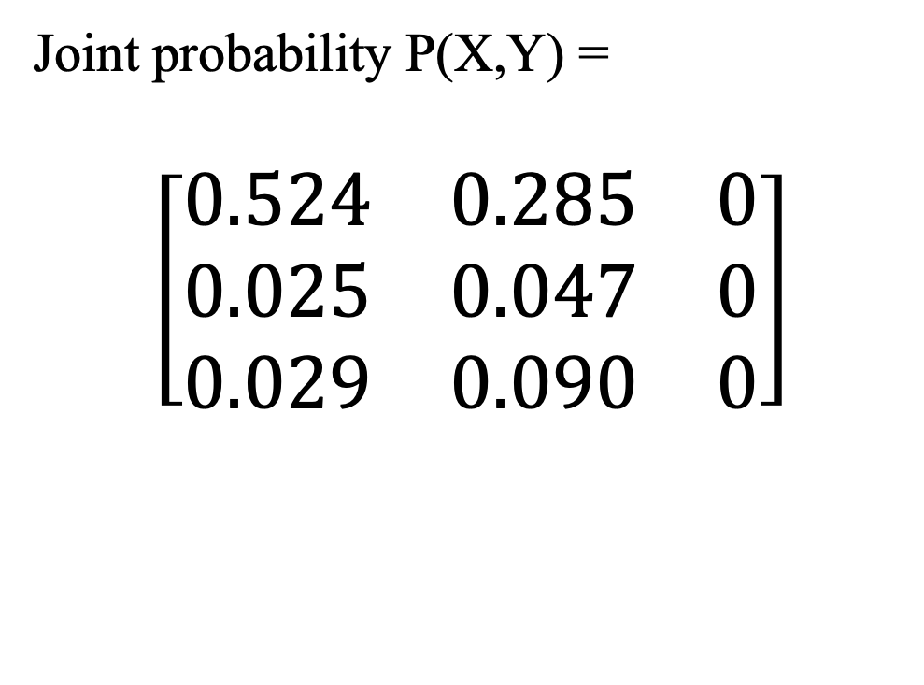
Joint Probability
Joint probability matrix for eye, X, and distance, Y.
Coarse binning for illumination: dark to light.
Illumination inversely proportional to distance.
Count & normalise co-occurrences.
Joint probability P(X,Y) =
$$\left[\begin{matrix}0.524 & 0.285 & 0 \\ 0.025 & 0.047 & 0 \\ 0.029 & 0.090 & 0\end{matrix}\right]$$
near far
dark
light

Slide 36
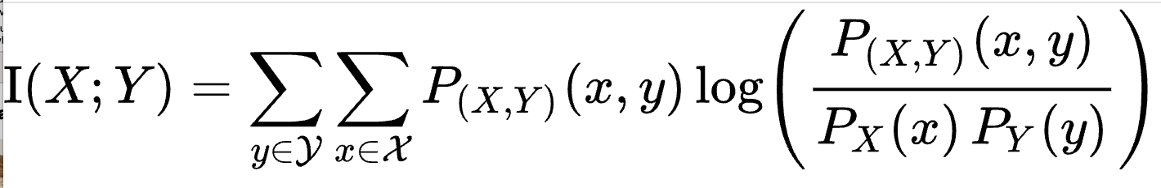
Mutual Information
the mutual information, I(X;Y), of two random variables X,Y, is a measure of the mutual dependence between them.
It quantifies how much information can be obtained about one random variable by observing the other. How much information they share.
I(X;Y) >= 0
I(X;Y) = I(Y;X)

Slide 37
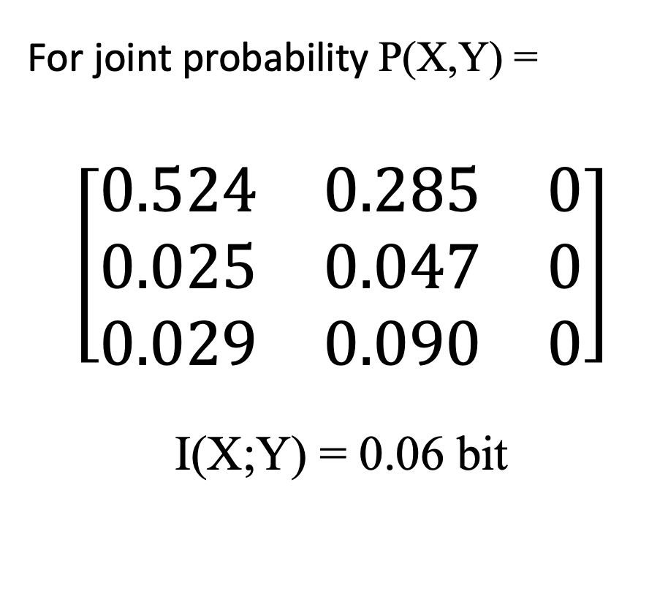
Mutual information of two variables
For joint probability P(X,Y) =
$$\left[\begin{matrix}0.524 & 0.285 & 0 \\ 0.025 & 0.047 & 0 \\ 0.029 & 0.090 & 0\end{matrix}\right]$$
I(X;Y) = 0.06 bit
Knowing X tells us exactly which of 2 states Y is in, and vice versa.
Represents log₂(2) = 1 bit
The eye shares just 0.06 bits with distance.
near far
dark
light

Slide 38
Discussion
Outgoing communication (control) Distance Y is controlled (in the face of disturbance).
Incoming communication (perception) The eye X, receives just 0.06 bits of information about the distance Y.
Conclusions
The feedback control loop is broken.
The vehicle exhibits open loop control.
It cannot be aware of distance.

Slide 39
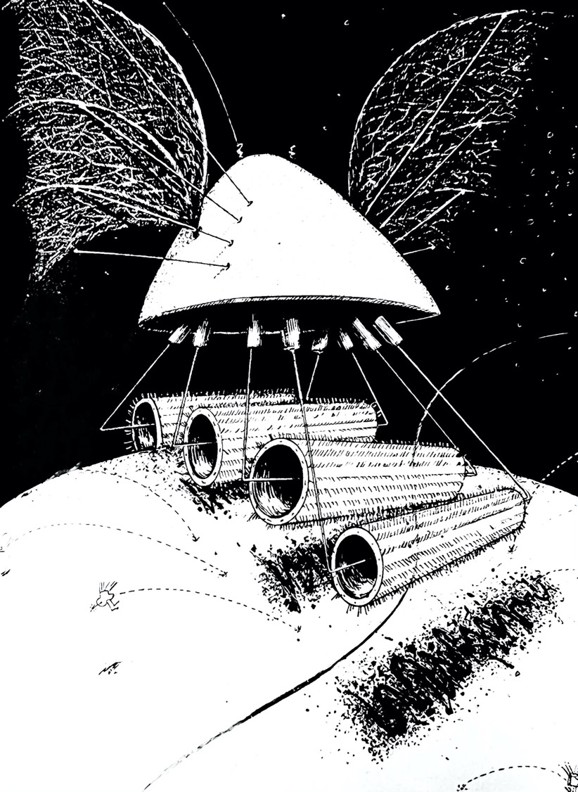
Vehicle 2: Fear & Aggression
Vehicle 2 equips our robot with a fight or flight response to light.
“It flees from light in fear, or heads towards it in a way that might be considered aggressive.” – Braitenberg
Notes:
Braitenberg teases us with these poetic purposeful descriptions.

Slide 40
Vehicle 2b: Aggression
“Vehicle 2b, “is excited by the presence of sources, but resolutely turns toward them and hits them with high velocity, as if it wanted to destroy them. Vehicle 2b is aggressive, obviously.” – Braitenberg

Slide 41
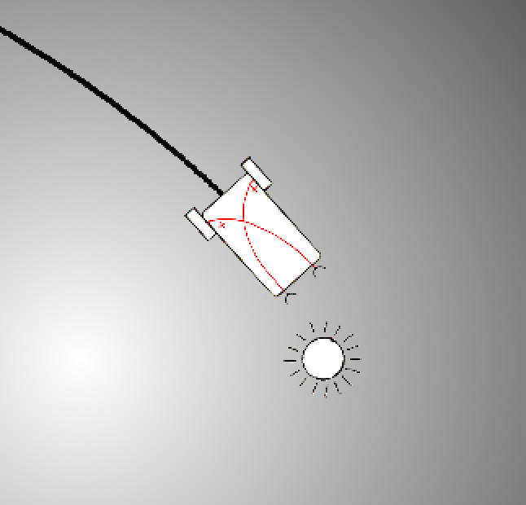
Vehicle 2b
Vehicle 2b connects each sensor to the motor on the opposite side.
If the light is brighter on one side of the vehicle, the motor on that side runs faster causing it to head towards the light.

Slide 42
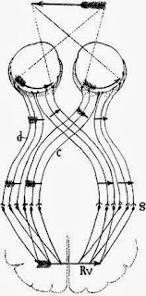
Crossing Connections
In 1899, Spanish neuroanatomist Ramón y Cajal observed optic nerve fibres from the half of the eye closest to the nose cross over to the opposite side of the brain.
Crossed connections are common in vertebrates, including us.
Nobody knows why.
Notes:
https://en.wikipedia.org/wiki/Santiago_Ramón_y_Cajal

Slide 43
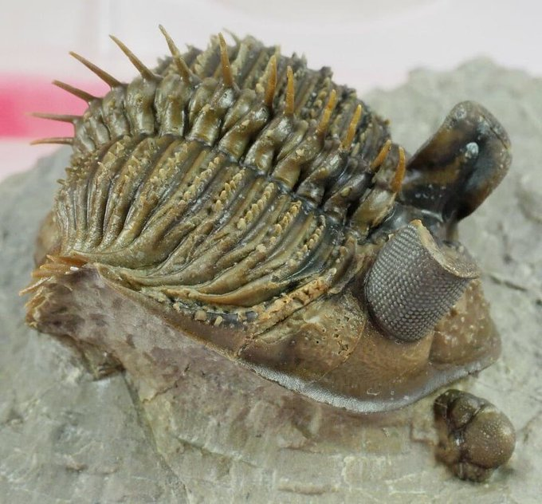
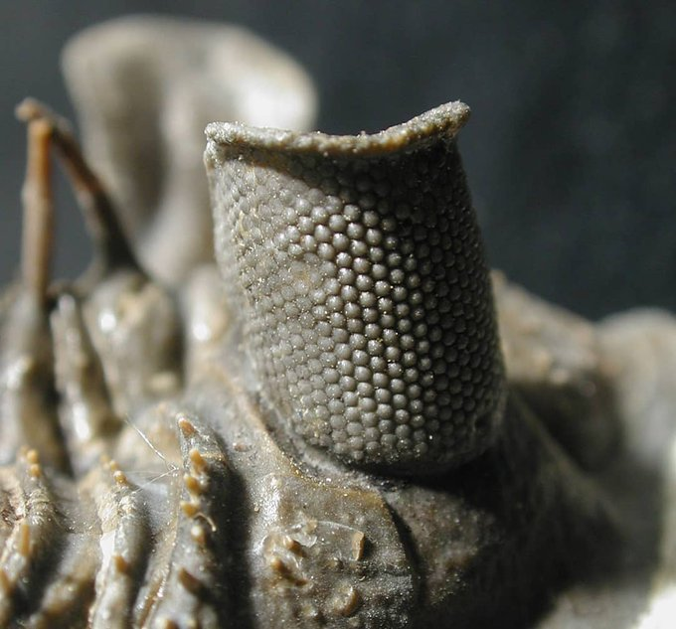
This trilobite is called Erbenochile. It had incredibly tall, tower-like eyes that provided 360-degree vision!
Fortey and Chatterton. 2003. A Devonian Trilobite with an Eyeshade. Science.
Notes:
https://twitter.com/Dean_R_Lomax/status/1417501261423906816

Slide 44
Paired eyes
Back-to-back photocells produce full (unrectified) cosine wave.
Eyes mounted 90∘ relative to each other produce sine and cosine waves.
Cross-coupling of the eyes to the motors computes the difference.
light dead-ahead is a stable equilibrium - it rushes ‘aggressively’ into the light.
There could be other equilibria.
$$\frac{\text{π}}{4}$$
dead ahead
The eyes of V2 produce a full-wave and are 90 ∘ out of phase.

Slide 45
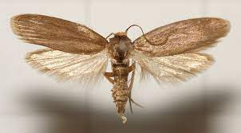
Dorsal Light reaction
Moths tend to keep the lighter sky above them so they don’t fly upside down.
They dip down when approaching an artificial light source that they confuse with the sky.
The wax moth
David Lees, Alberto Zilli, Moths: A Complete Guide To Biology And Behavior

Slide 46

Experiment 2
Vehicle 2 reaches a stable clockwise or anti-clockwise orbit around the light.
Let it reach equilibrium before observing.
Hypothesis: The controlled variable is the angle to the light source.
Hypothesis: There is significant mutual information between the two eyes and the angle.
https://bit.ly/3TzssLM

Slide 47
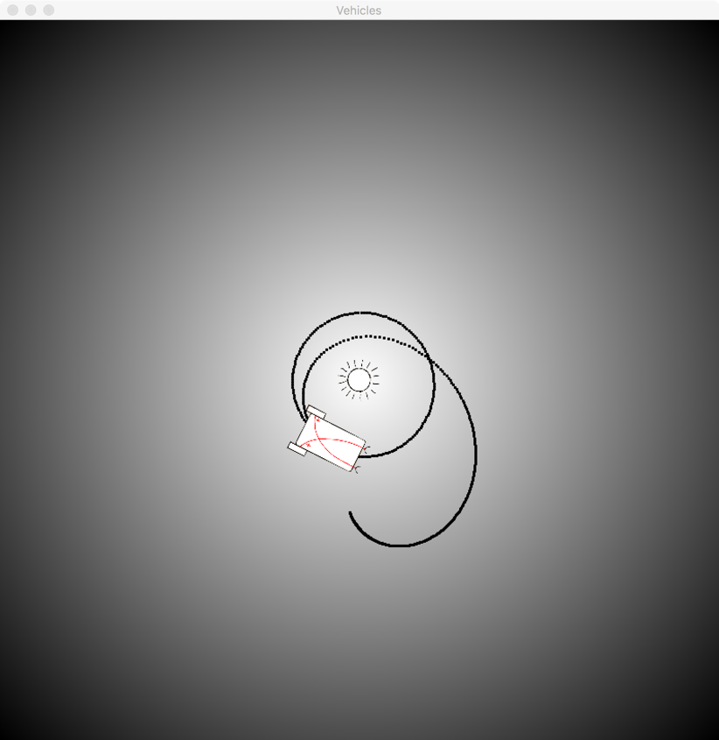
Experiment 2
Vehicle 2 reaches a stable clockwise or anti-clockwise orbit around the light.
Let it reach equilibrium before observing.
Hypothesis: The controlled variable is the angle to the light source.
Hypothesis: There is significant mutual information between the two eyes and the angle.

Slide 48
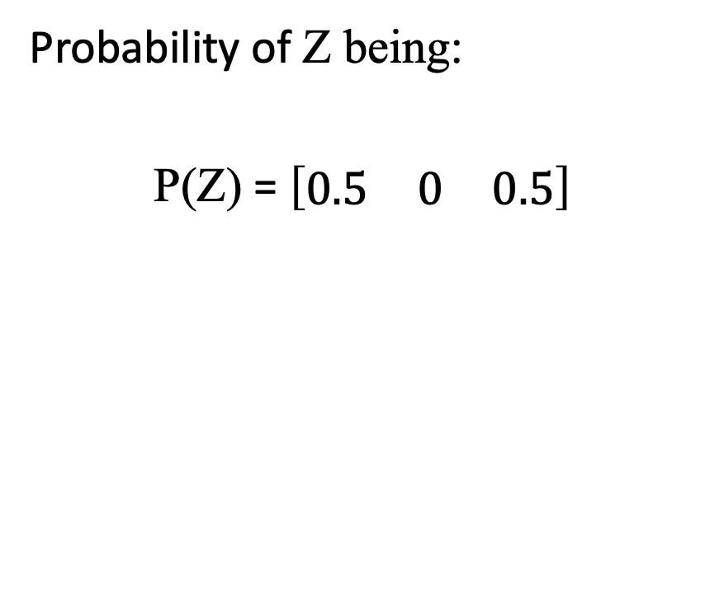
Test for the Controlled Variable
Is the angle to the light source, Z, under control?
Intermittently disturb the vehicle to see which states it settles back into.
Coarse distinction of 3 bins
Count & normalise occurrences.
Probability of Z being:
P(Z) = $\left[\begin{matrix}0.5 & 0 & 0.5\end{matrix}\right]$
left ahead right

Slide 49
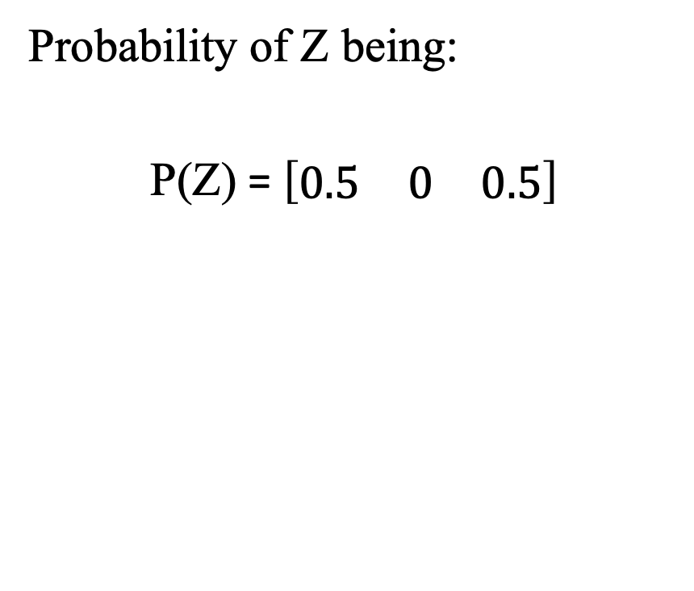
Entropy
The entropy of the angle, Z, H(Z) = 1 bit
H(Z) increases with uncertainty.
There are only two specific states it returns to.
Evidence of stable equilibria.
Evidence of control.
Probability of Z being:
P(Z) = $\left[\begin{matrix}0.5 & 0 & 0.5\end{matrix}\right]$
left ahead right
H(Z) = 1 bit

Slide 50
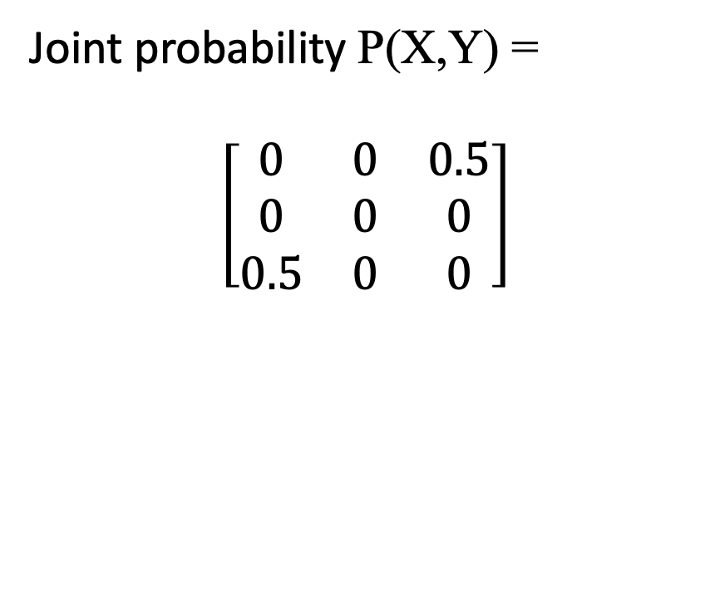
Joint Probability
X,Y are the left and right eyes
Coarse binning for illumination: dark to light.
Count & normalise co-occurrences.
Joint probability P(X,Y) =
$$\left[\begin{matrix}0 & 0 & 0.5 \\ 0 & 0 & 0 \\ 0.5 & 0 & 0\end{matrix}\right]$$
right dark right light
left dark
left light

Slide 51
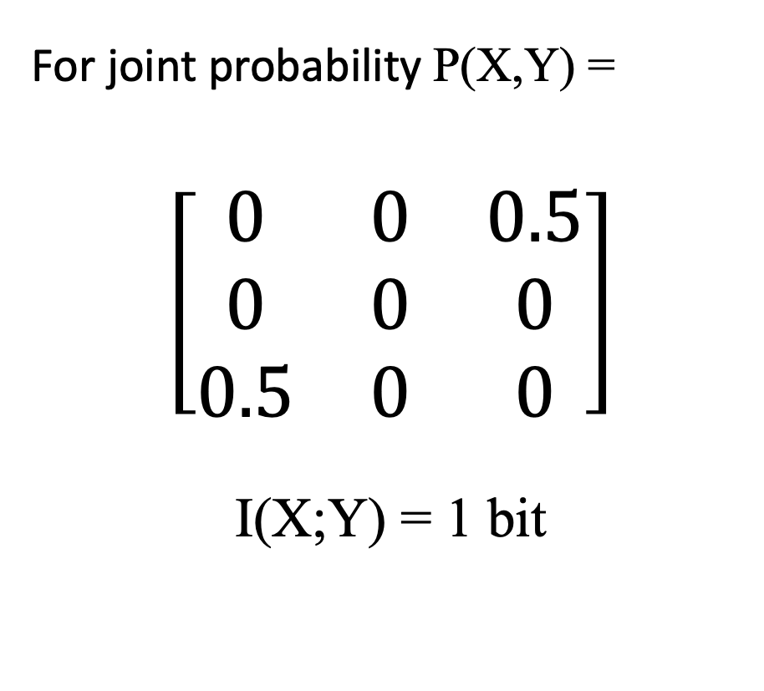
Mutual information of two variables
For joint probability P(X,Y) =
$$\left[\begin{matrix}0 & 0 & 0.5 \\ 0 & 0 & 0 \\ 0.5 & 0 & 0\end{matrix}\right]$$
I(X;Y) = 1 bit
Knowing X tells us exactly which of 2 states Y is in, and vice versa.
Represents log₂(2) = 1 bit
The eyes share 1 bit of information.
right dark right light
left dark
left light

Slide 52
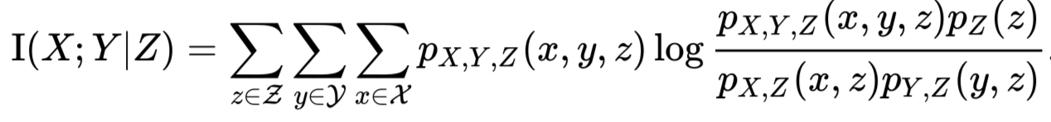
Conditional mutual information
The mutual information I(X;Y|Z) of two random variables X,Y conditioned on a third, Z.

Slide 53
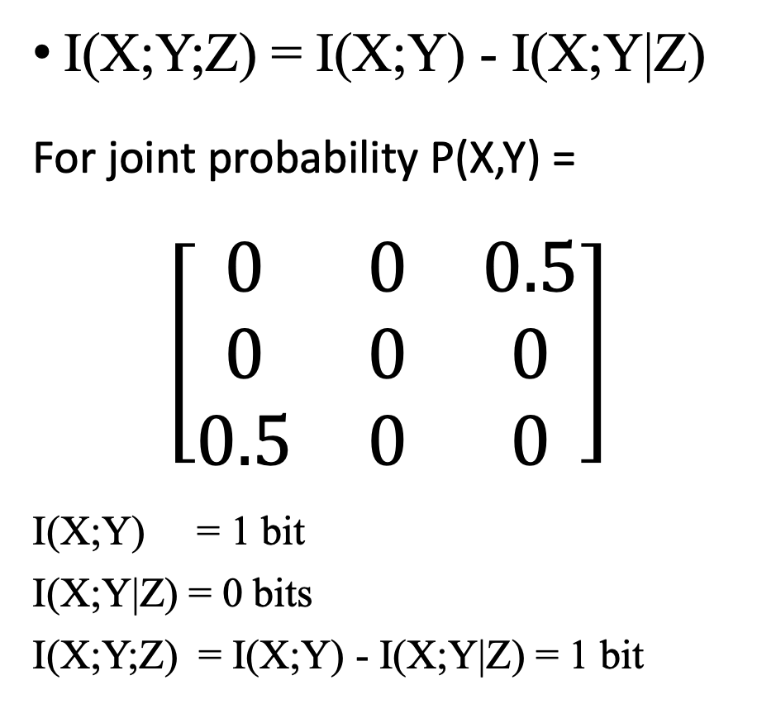
Mutual information of three variables
Z is the angle to the light source, the controlled variable.
I(X;Y|Z) is a conditional mutual information given Z (angle).
When the angle is known, the light level in the eyes is completely determined, so there is no information between them.
The 1 bit indicates which of the two stable states it’s in.
I(X;Y;Z) = I(X;Y) - I(X;Y|Z)
For joint probability P(X,Y) =
$$\left[\begin{matrix}0 & 0 & 0.5 \\ 0 & 0 & 0 \\ 0.5 & 0 & 0\end{matrix}\right]$$
I(X;Y) = 1 bit
I(X;Y|Z) = 0 bits
I(X;Y;Z) = I(X;Y) - I(X;Y|Z) = 1 bit
right dark right light
left dark
left light

Slide 54
Discussion
Outgoing communication (control) The angle Z is controlled (in the face of disturbance).
Incoming communication (perception) The eyes X,Y receive 1 bit of information about the vehicle angle Z.
Conclusion
The vehicle exhibits closed loop control of its angle to the light source.
A 1 bit consciousness?

Slide 55
Futuring

Slide 56
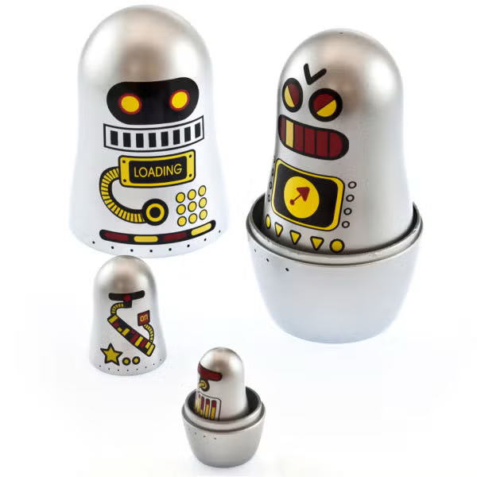
Matryoshka
To a first approximation cyber-consciousness asserts that consciousness operates at the control surface of an organism.
What of ‘inner voice’ or ‘mental imagery’?
Ashby acknowledges that the division between the organism and environment is somewhat arbitrary.
Perceptual Control Theory holds that control systems can be layered and nested within each other.

Slide 57
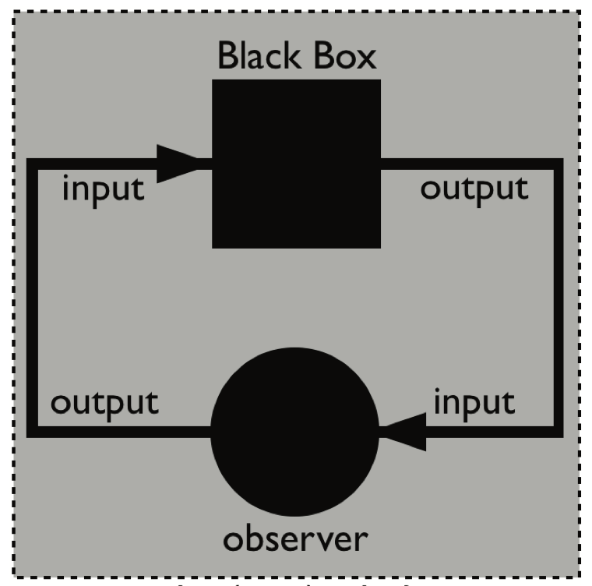
Self Awareness
Through self-observation we interact with our own descriptions and can describe ourselves describing ourselves in an endless recursive process.
“Everything said is said by an observer to an observer who could be him/herself”
– Humberto Maturana
= ?
“The Black Box and observer. We can’t see inside the Black Box because there is no inside.” – Ranulph Glanville.
Notes:
Everything said is saidby an observer to an observerwhocould be him/herself(MaturanaandVarela, 1980; p. 8) and believes that throughsuch self-observation we interact with our owndescriptions and can describe ourselves describing ourselves in an endless recursive process.
page 8
http://ranulphglanville.org.za/wp-content/uploads/2023/06/A-Cybernetic-Musing-Black-Boxes.pdf

Slide 58
Fin

